Slide 2
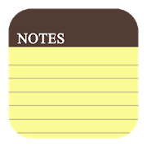
Remember to write Titles, Objectives, dates and underline with a ruler!
This means that you will need to make notes in your exercise book.
This means that this is the section that you will need to make notes on
© Pearson Education Ltd 2020. Copying permitted for purchasing institution only.

Slide 3

Learning objectives
In this lesson you will learn to:
  use relational operators in flowcharts and code
  use 'if' and 'if else' in code
  use the flowchart decision symbol.
For more information on this topic, and additional student activities, see Topic 1.4 of the student book.
© Pearson Education Ltd 2020. Copying permitted for purchasing institution only.
Notes:
Specification content: 1.2.1 1.2.3 6.1.3 6.2.1 6.2.2 6.5.2

Slide 4
Programming structures
Previously, we discussed sequence in programming.
Remember that sequence is the order in which steps are carried out – one after another.
Another key programming structure that you need to be able to use is selection.
Selection is all about making decisions. The program chooses a path through the algorithm based on certain conditions.
© Pearson Education Ltd 2020. Copying permitted for purchasing institution only.

Slide 5
Relational operators
Selection relies on conditions. A condition is a statement which compares one value with another. The result of the comparison can be true or false.
There are several conditions that you need to be able to use.
== | Equal to
< | Less than
> | Greater than
!= | Not equal to
<= | Less than or equal to
>= | Greater than or equal to
Note the double equals symbol here. Single = is used to assign values to variables. Confusing these two symbols is a common bug.
© Pearson Education Ltd 2020. Copying permitted for purchasing institution only.
Notes:
Student Activity 1

Slide 6
Decisions
So how do you implement selection?
In a flowchart, there is a new symbol: the decision symbol (a diamond shape).
Let’s look at an example.
You ask a question.
If the answer is ‘yes’, you carry out
a particular action.
But what if the answer is ‘no’?
You need to add another path that can be taken.
Weather == “rain”?
Yes
Output “take an umbrella”
© Pearson Education Ltd 2020. Copying permitted for purchasing institution only.
Notes:
Student Activity 1

Slide 7
Decisions
So now you have two possible paths through the algorithm.
Weather == “rain”?
No
Yes
Output “take an umbrella”
Output “no need for the umbrella today”
© Pearson Education Ltd 2020. Copying permitted for purchasing institution only.
Notes:
Student Activity 2

Slide 8
If
In Python, we use an if statement to produce the same effect:
The condition goes first.
You must put a colon at the end of this line.
if weather == "rain":
print("Take an umbrella")
else:
print("No need for the umbrella today.")
The next line(s) is indented. Your Integrated Development Environment (IDE) may do this for you, but you might need to do it yourself. Indentation is important in Python as your code will not run if it’s incorrect.
If the condition is true, the code indented under the if runs. If the condition is false, the code indented under the else runs instead.
© Pearson Education Ltd 2020. Copying permitted for purchasing institution only.
Notes:
Student Activities 3 and 4

Slide 9
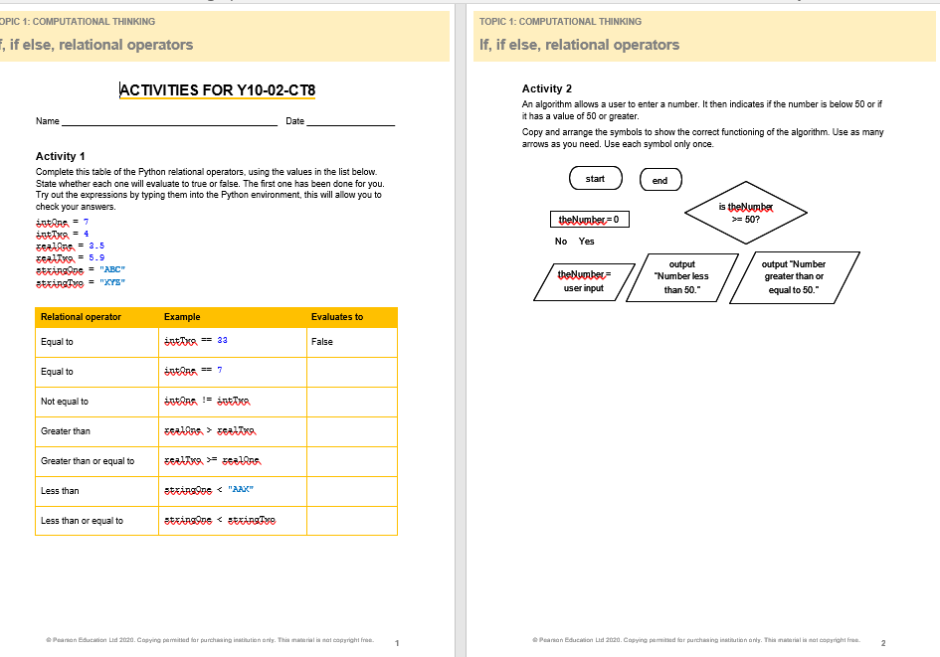
Task – Complete Tasks 1 & 2 in your books
Use a ruler for all straight lines!
Then tasks 3 and 4 on computer
© Pearson Education Ltd 2020. Copying permitted for purchasing institution only.

Slide 10
Wrap up, you have learned how to . . .
Use relational operators in flowcharts and code.
  You looked at the symbols used to represent less than, more than, equals to, etc.
Use 'if' and 'if else' in code.
  If statements have extra syntax that you need to remember to place the colon at the end of the line, and to check that the next line(s) is indented.
Use the flowchart decision symbol.
  The diamond shape. One arrow in and two out (only). It must contain a yes/no question.
© Pearson Education Ltd 2020. Copying permitted for purchasing institution only.

